Slide 1
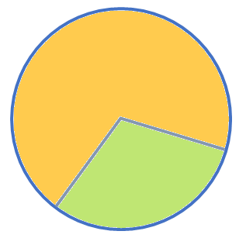
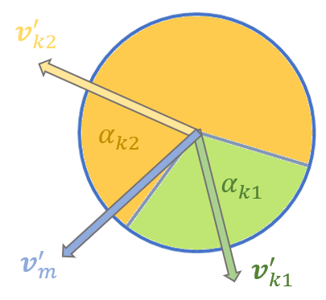
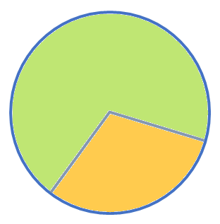
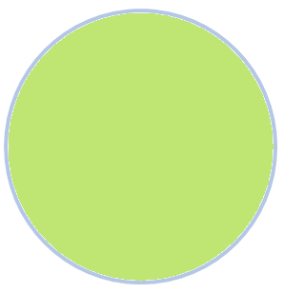
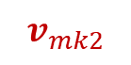
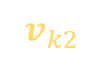
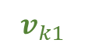
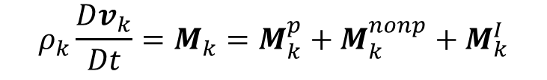
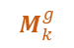
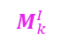
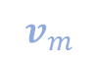
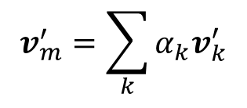
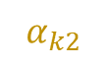
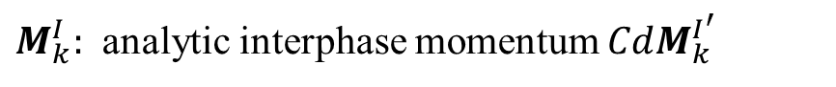
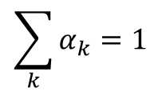

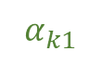
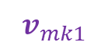
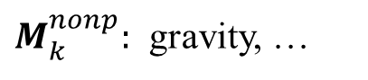
Volume Fraction Scheme
Momentum source in Implicit-Mixture-Model
$$v_{mk2}$$
$$ρ_{k}\frac{Dv_{k}}{Dt}=M_{k}=M_{k}^{p}+M_{k}^{nonp}+M_{k}^{I}$$
$$v_{k2}$$
$$v_{m}$$
$$v_{mk1}$$
$$\sum_{k}{α_{k}=1}$$
$M_{k}^{p}:$ VFSPH Solver with Momentum Mapping
$$α_{k2}$$
$$v_{k1}$$
$M_{k}^{nonp}:$ gravity, …
$$α_{k1}$$
$M_{k}^{I}:$ analytic interphase momentum $CdM_{k}^{I^{′}}$
Momentum contribution
$$M_{k}^{p}$$
change phase-vel
reconstruct mix-vel
$$v_{m}^{′}=\sum_{k}{α_{k}v_{k}^{′}}$$
$$M_{k}^{I}$$
$$M_{k}^{g}$$

Slide 2

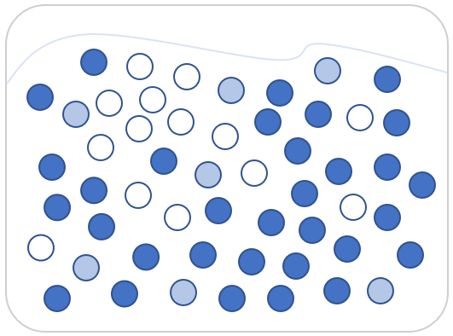


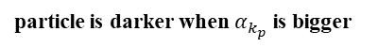
pure water phase
Region-1
pure polymer phase
particle is darker when $α_{k_{p}}$ is bigger
Region-3
Region-2

Slide 3
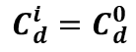
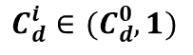
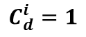
$$i$$
$$i$$
$$i$$
$$C_{d}^{i}=C_{d}^{0}$$
$$C_{d}^{i}=1$$
$$C_{d}^{i}∈(C_{d}^{0},1)$$

Slide 4
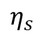
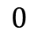
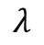
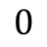
Viscous
Elastic
$$0$$
$$λ$$
Fluid
Solid
$$0$$
$$η_{s}$$

Slide 5
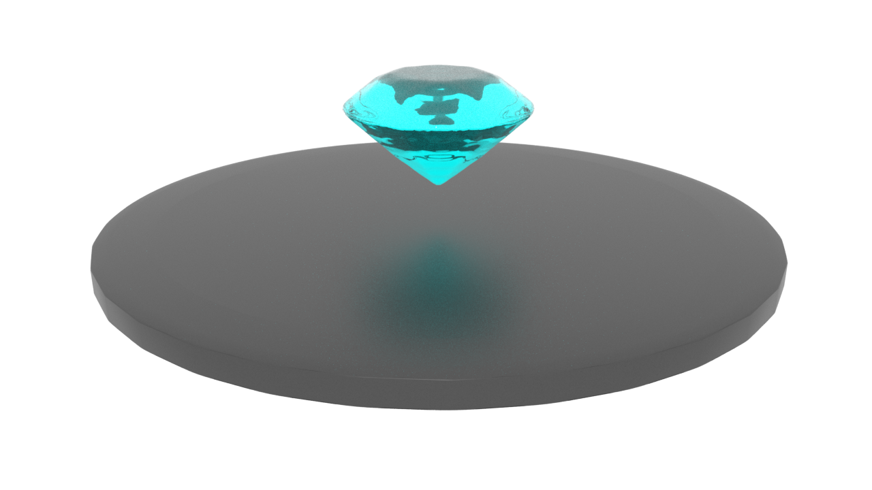
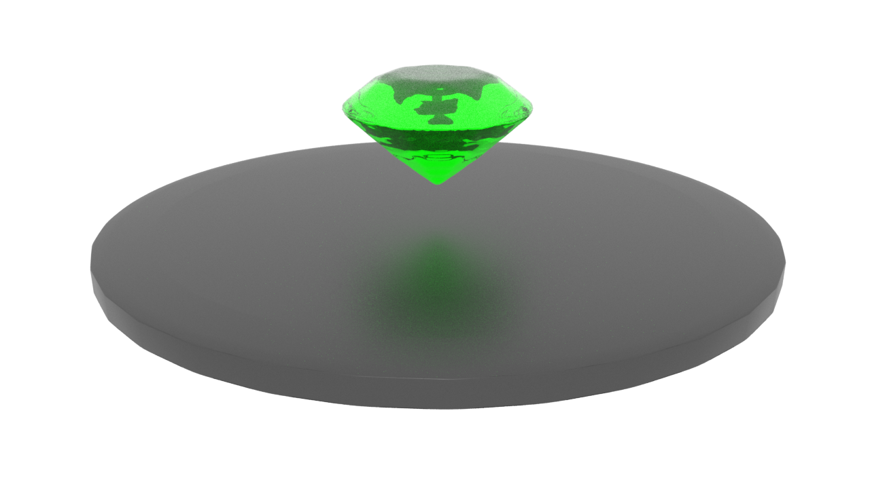
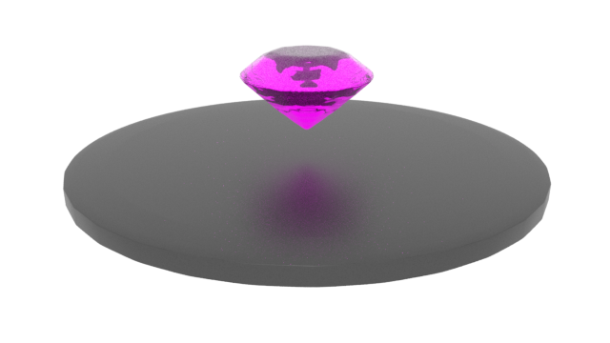
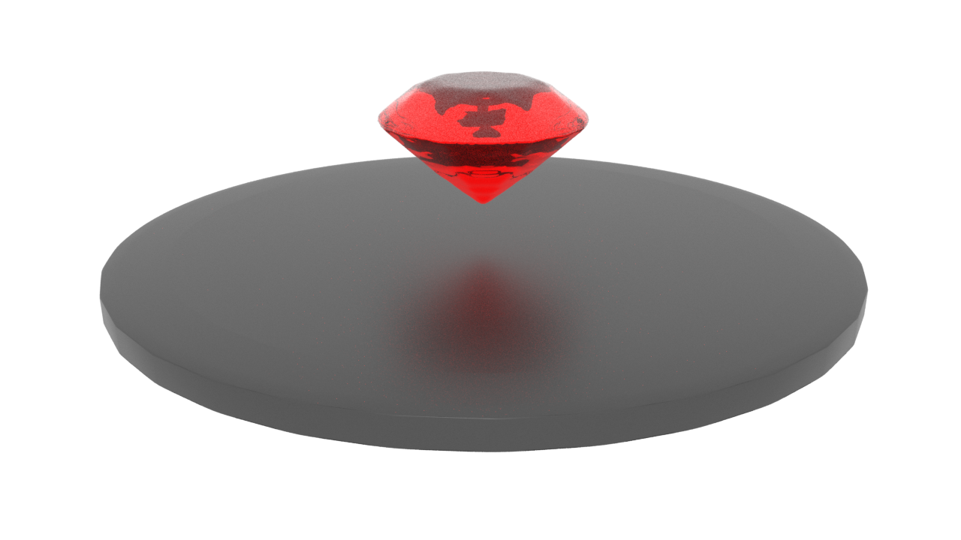
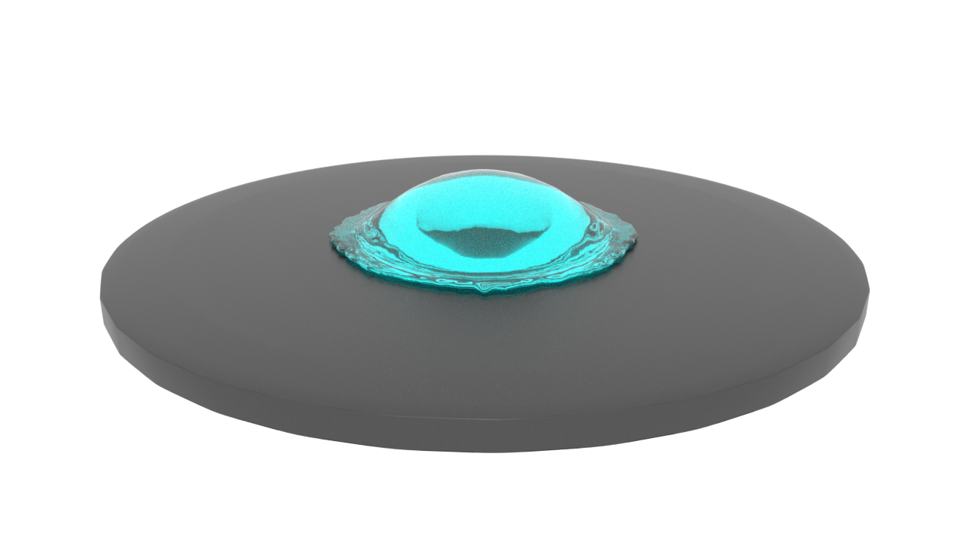
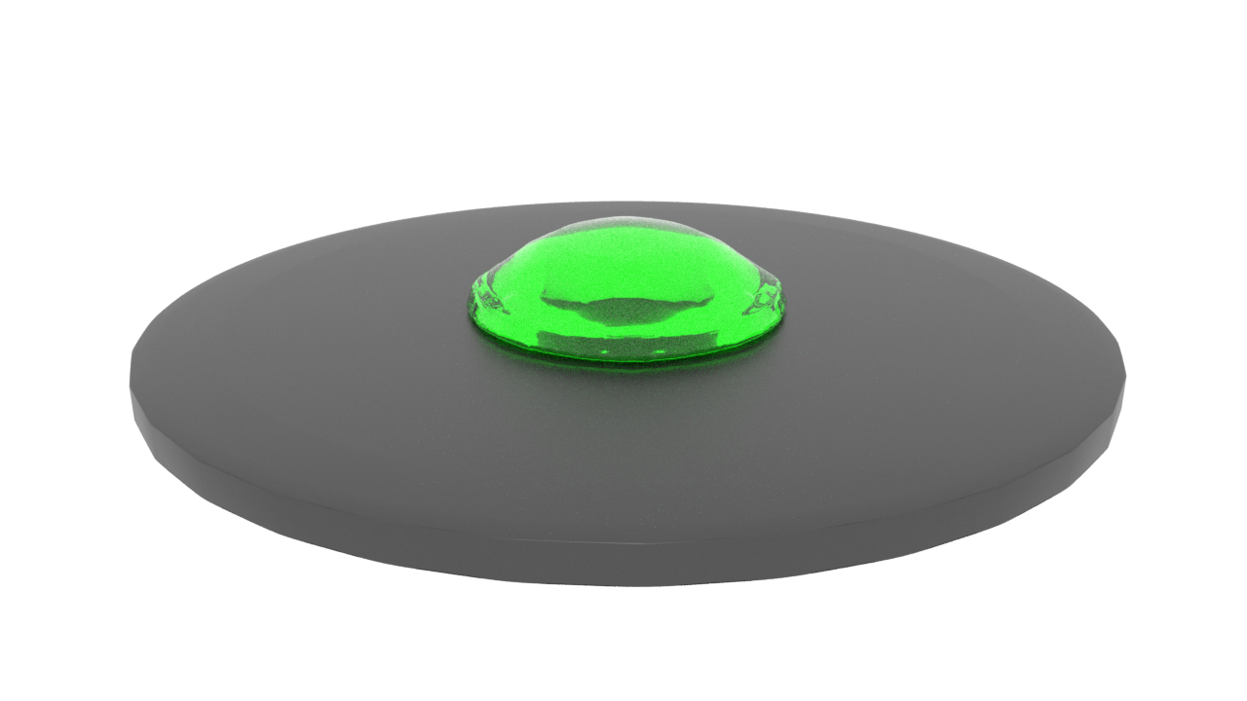
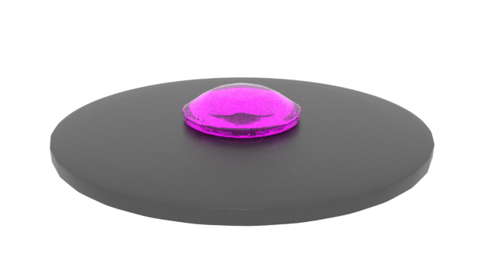
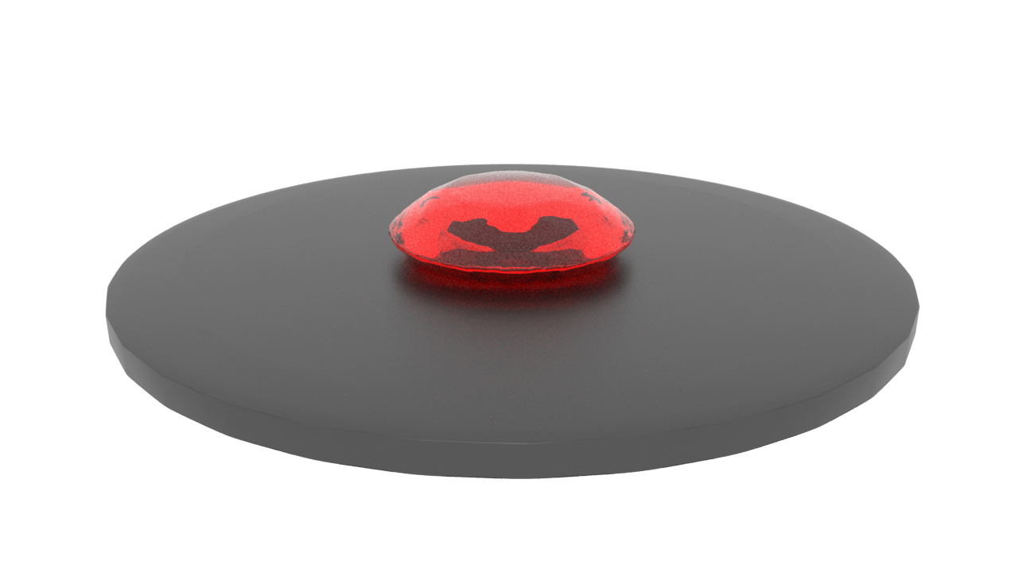
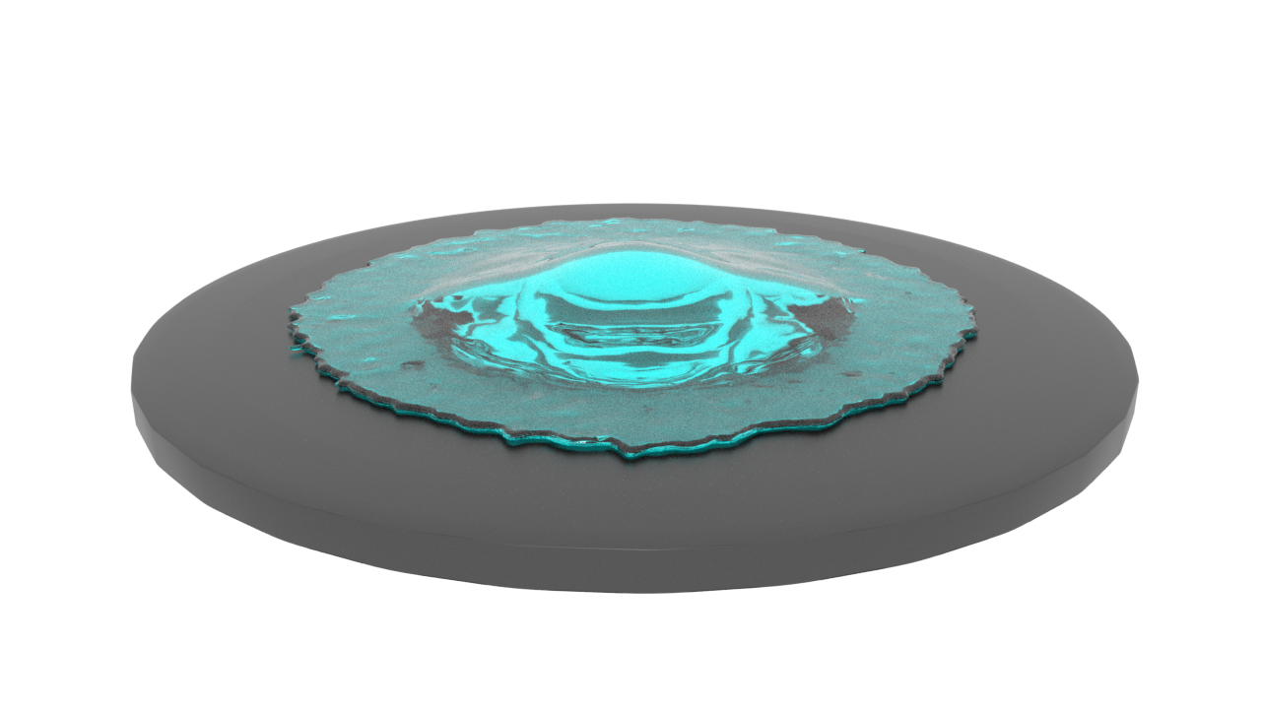
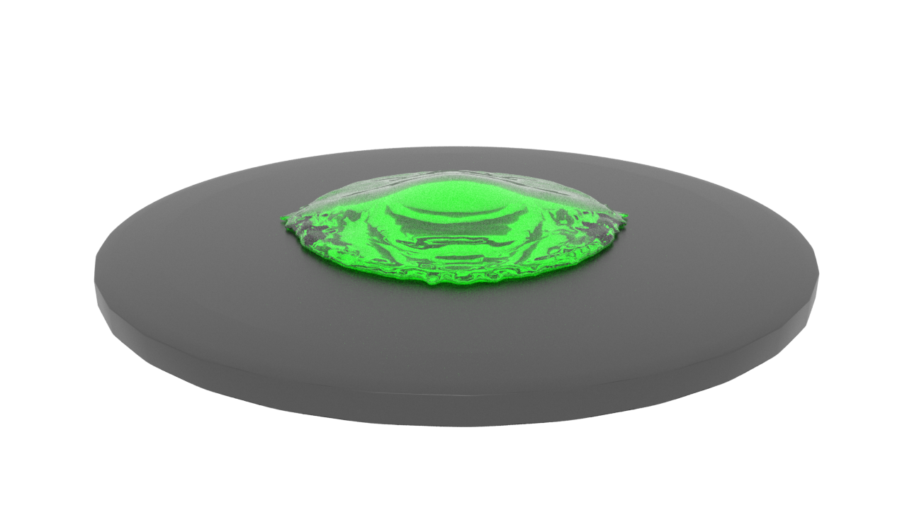
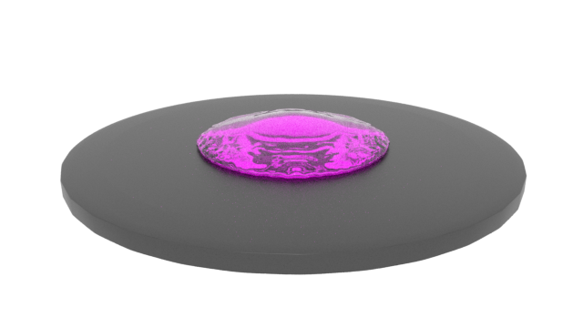
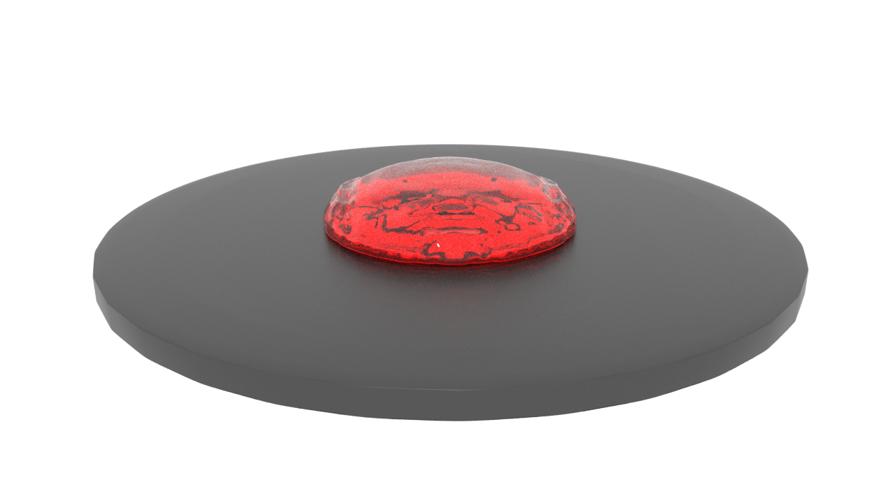
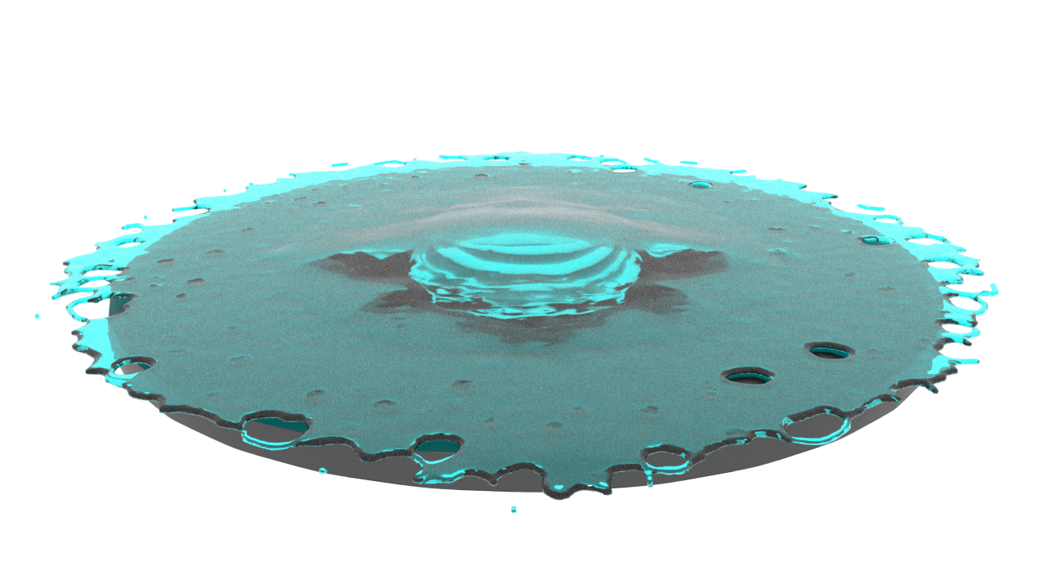

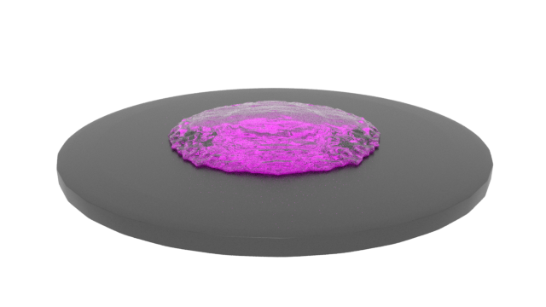
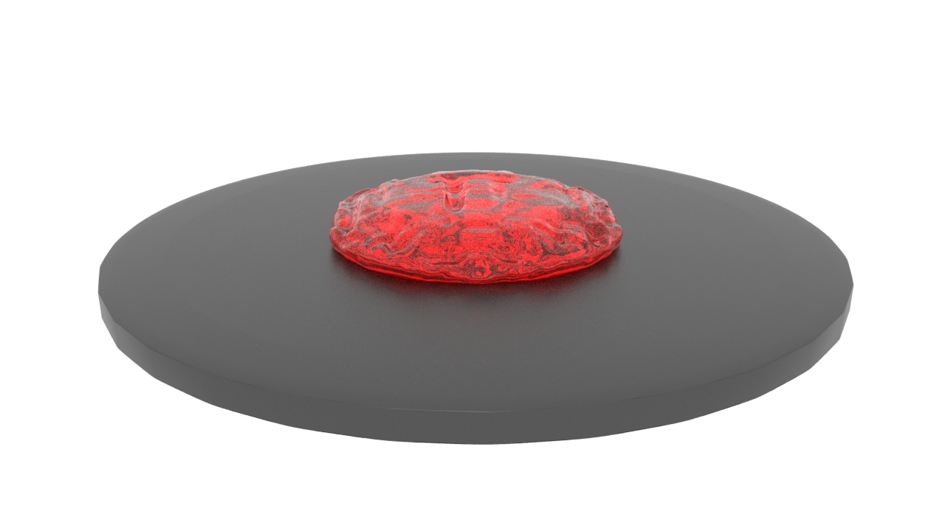
t=0.01s
t=1.55s
t=1.85s
t=2.1s

Slide 6
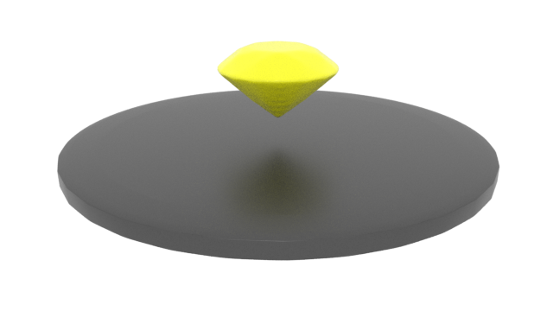
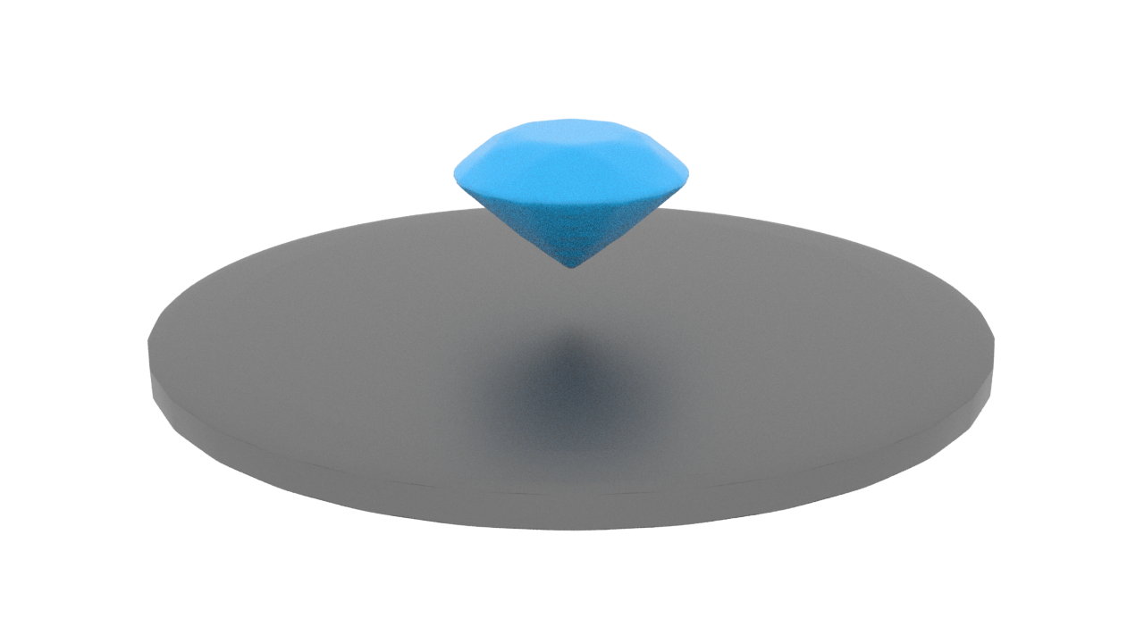
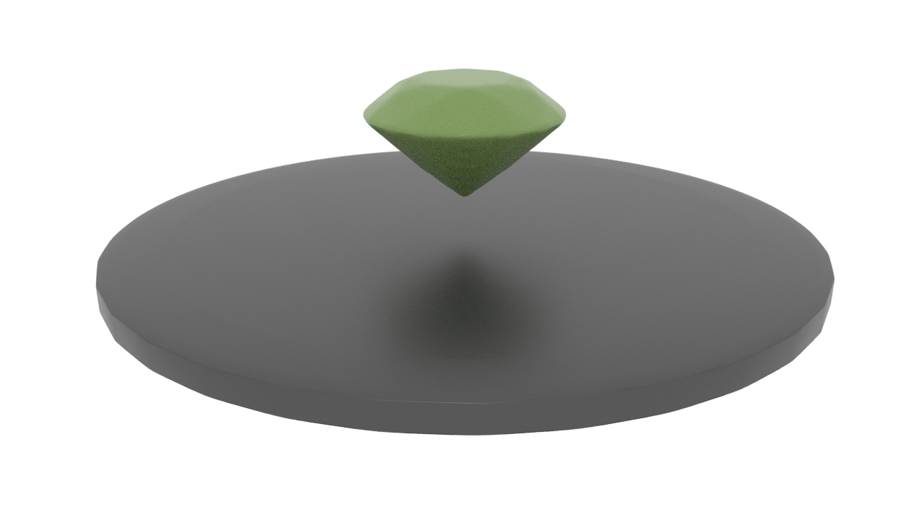
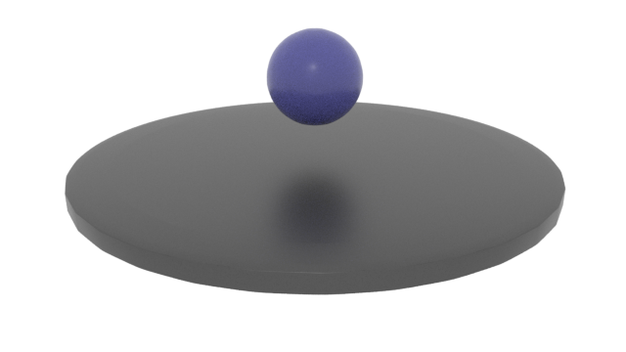
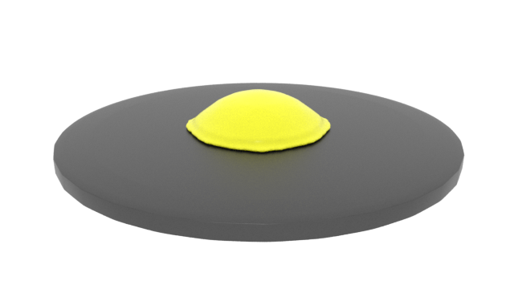
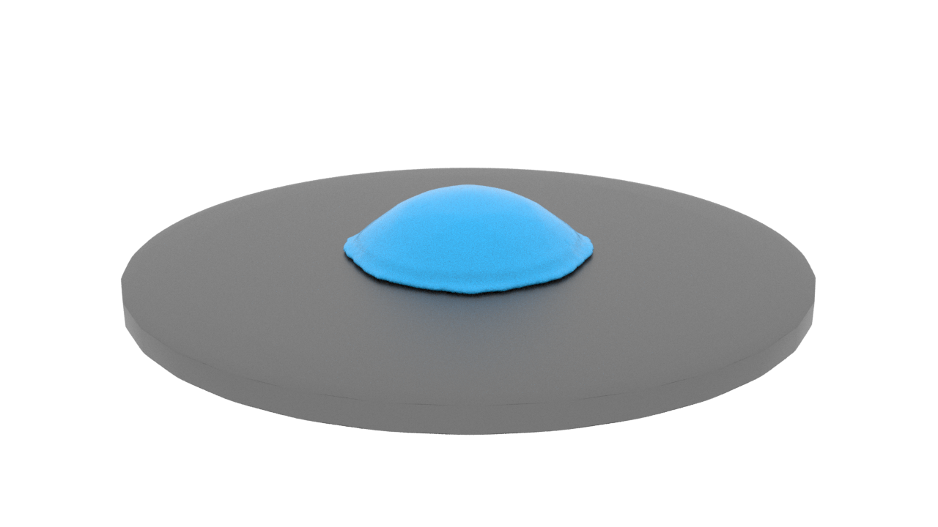
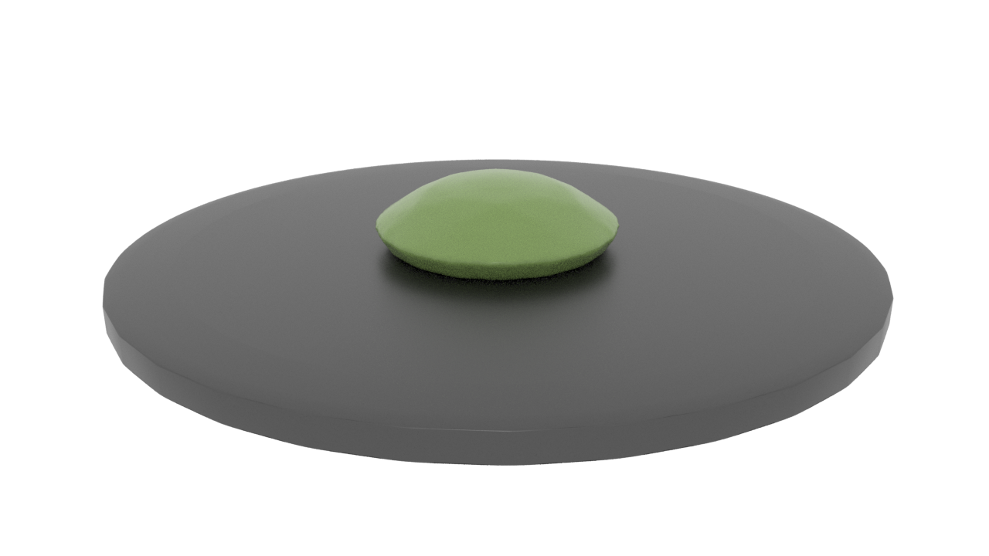
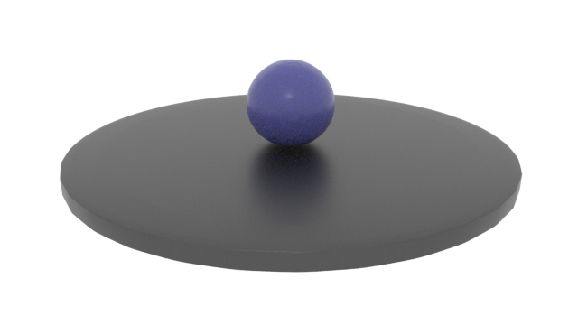








t=0.01s
t=1.55s
t=1.85s
t=2.1s

Slide 7



Slide 8



t=0s
t=1.5s
t=3.5s

Slide 9






DFSPH with explicit laplacian viscosity
Ours

Slide 10






Slide 11








Original Implicit Mixture Model
Bonding Effect Network
t=0.22s
t=3.37s
t=5.62s
t=13.5s

Slide 12



Slide 13






Slide 14



Viscoelasticity
$$α_{k_{p}}≥α_{0}$$
Base
$$α_{k_{p}}=0$$
$$α_{k_{p}}<α_{0}$$
Shear rate

Slide 15





